Slide 1
Guided Capstone: Big Mountain Resort
Varshini Chellapilla
Springboard

Slide 2
Current Situation
Big Mountain Resort, located in Montana, is a ski resort hosting 105 trails alongside the Glacier National Park and Flathead National Forest. With approximately 350,000 annual visitors at the resort for skiing or snowboarding for an average stay of 5 days, the resort is serviced by 11 lifts, 2 T-bars, and 1 magic carpet for novice skiers.
The current operating costs have increased by $1.54 million due to the addition of a chair lift in an effort to increase the distribution of visitors across the mountain. Big Mountain Resort currently charges $81.00 for an adult ticket for both weekdays and weekends.
The management at Big Mountain Resort suspect that more can be done to capitalize on its facilities and improve ticket pricing to increase revenue. In order to do so, the company has obtained data on every resort in Big Mountain’s market segment.

Slide 3
Problem Identification
How can Big Mountain Resort increase revenue by recovering the additional $1.54 million, reducing other operating costs and improving the usage of facilities by next season?
The following options have been shortlisted by the business:
Permanently closing down up to 10 of the least used runs. This doesn't impact any other resort statistics.
Increase the vertical drop by adding a run to a point 150 feet lower down but requiring the installation of an additional chair lift to bring skiers back up, without additional snow making coverage
Same as above, but adding 2 acres of snow making cover
Increase the longest run by 0.2 mile to boast 3.5 miles length, requiring an additional snow making coverage of 4 acres

Slide 4
Exploratory Data Analysis and Pre-Processing
The EDA method is important for the understanding of the data at hand and identifying patterns or assumptions in the available data. One of the key parts of exploratory data analysis is feature engineering, which aims to create and utilize predictors that help the formation of a prediction model in the later stages. It also helps in the comprehension of relationships between various features.
1
A series of scatter plots were created to explore the relationship between ticket prices and each numerical feature in the dataset. From this, we are able to conclude that the following features could be used for subsequent modeling: Runs, Snow Making AC, Total Chairs, Vertical Drop, Fast Quads, and Resorts Per 100,000 People.
2

Slide 5
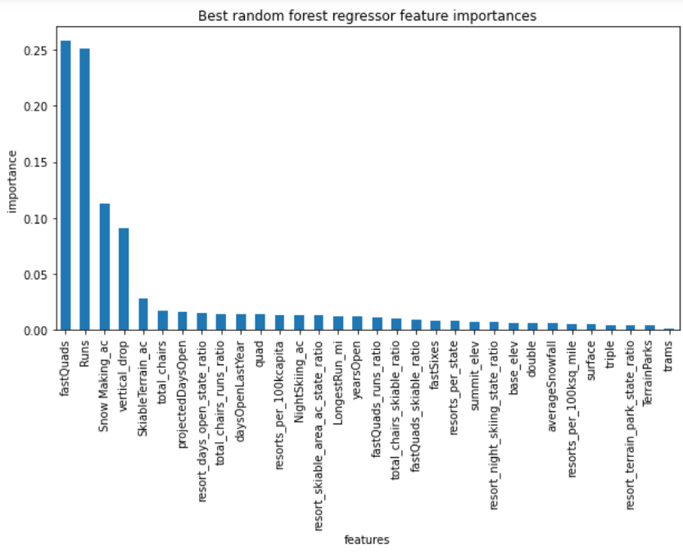
Modelling and Analysis
Two different models developed in the Pre-Processing and Training stage: a Linear model and a Random Forest model. The Random Forest model was found to have a lower cross-validation mean absolute error by almost $1. It also exhibited less variability.
The model employed suggests that the ticket price could be increased to $95.87. Even with the expected mean absolute error of $10.39, this suggests there is room for an increase.

Slide 6
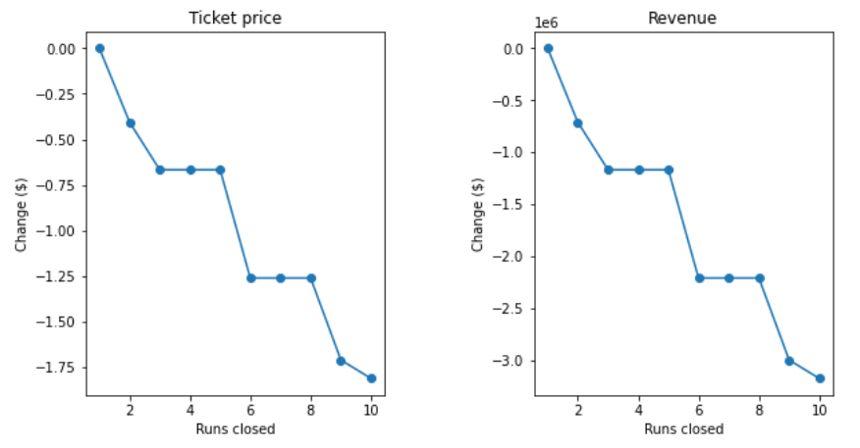
Modelling and Analysis (cont.)
Among these options, the model says closing one run makes no difference. Closing 2 and 3 successively reduces support for ticket price and so revenue. Closing down 3, 4 or 5 runs, results in no further loss in ticket price. However, increasing the closures down to 6 or more leads to a large drop.
0.0
Change in Ticket Price or Revenue upon the closure of 1 run.

Slide 7
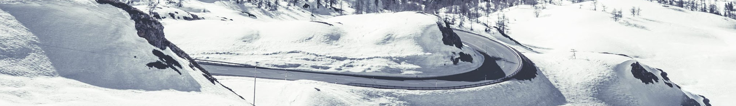
Recommendation
Increase ticket price from $81.00 to $95.87 immediately. Observe effects of change.
Close one run, as it will have no impact on ticket price or revenue. This will help decrease operational costs for the business.

